Slide 1
CSE499A.10 - Transfer Learning
Group members Name and Id:
1. Md Sehabub Zaman Pranta - 1611251042
2. Tanvir Ahmed – 1410982042
3. Jannatul Ferdouse Onny - 1631561042
4. Sadia Ahmed Tandra – 1631474042
5. Rokeya Akanda Sriti- 1620165042

Slide 2
What is Transfer Learning?
Transfer learning is the use of the knowledge gained while solving one problem and applying it to a different but related problem.
For example, knowledge gained while learning to recognize cars can be used to some extent to recognize trucks.

Slide 3
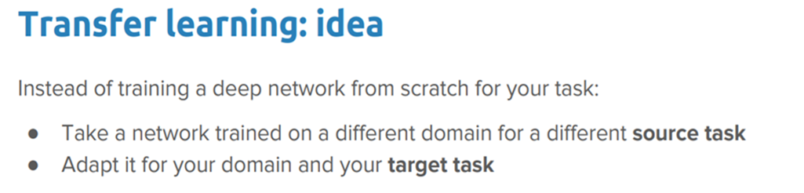
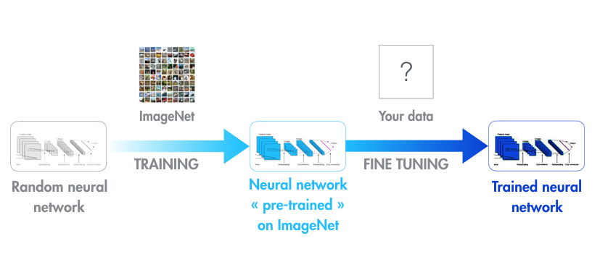

Slide 4
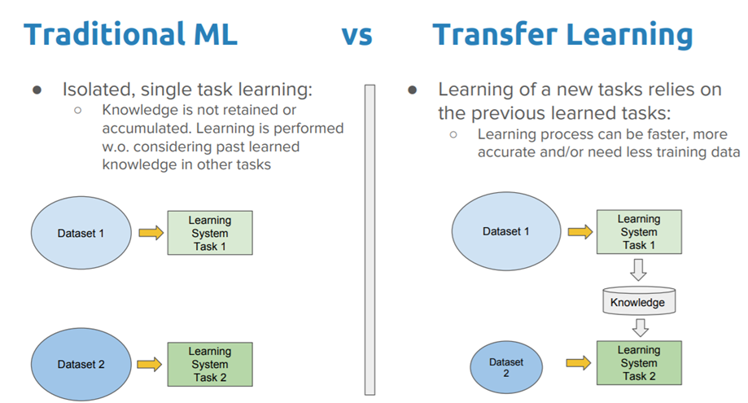

Slide 5
Approaches To Transfer Learning
Training A Model to Reuse It - Imagine we want to solve task A but don’t have enough data to train a deep neural network. One way around this is to find a related task B with an abundance of data. Train the deep neural network on task B and use the model as a starting point for solving task A.
Using A Pre-trained Model - The second approach is to use an already pre-trained model. Keras, for example, provides nine pre-trained models that can be used for transfer learning, prediction, feature extraction and fine-tuning.

Slide 6
Popular Pre-trained Models
Inception-v3 model, which was trained for the ImageNet “Large Visual Recognition Challenge."
Microsoft also offers some pre-trained models, available for both R and Python development, through the MicrosoftML R package and the Microsoftml Python package.
Other quite popular models are ResNet (Short for Residual Network. most popularly used for image classification)
And AlexNet (a significantly “old” image classification algorithm that performs well on ImageNet.)

Slide 7
Why Transfer Learning?
Transfer learning is useful when we have insufficient data for a new domain we want handled by a neural network and there is a big pre-existing data pool that can be transferred to our problem.
So we might have only 1,000 images, but by tapping into an existing CNN such as ResNet, trained with more than 1 million images, we can gain a lot of low-level and mid-level feature definitions.
Transfer learning will become a key driver of Machine Learning success in industry.

Slide 8
Thank You

